Slide 1
Module 5
Gene Alterations

Slide 2
Outline
Introduction to module
Gene alterations and their consequences
Overview of gene alterations
Genetic mutations
Finding gene mutations
Methylation
Finding methylated genes
Copy number alterations
Finding copy number alterations
Genomic alterations and gene expressions
Linking genomic alterations and gene expressions
Gene alterations with R
R scripts to determine gene alterations

Slide 3
Learning Objectives
1. Determine whether genes are altered and if they are which type of alteration they have.
2. Write R scripts to determine gene alterations and their types.

Slide 4
Introduction to Module
This module studies the important topic of gene alterations.
Genomic alterations (in the DNA) are often presented as causing transcriptomic alterations (in the RNA or proteins), which means that changes in the genes often cause changes in the level of expression of genes.
We will study different types of genetic alterations such as somatic mutations, copy number alterations, and methylations since they are major types of gene alterations.
R provides many useful functions for the detection and quantification of gene alterations of several types.

Slide 5
Outline
Introduction to module
Gene alterations and their consequences
Overview of gene alterations
Genetic mutations
Finding gene mutations
Methylation
Finding methylated genes
Copy number alterations
Finding copy number alterations
Genomic alterations and gene expressions
Linking genomic alterations and gene expressions
Gene alterations with R
R scripts to determine gene alterations

Slide 6
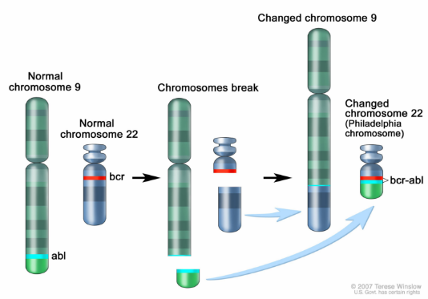
Gene Alterations and their Consequences
In some diseases, it has been shown that gene alterations cause or are closely associated with the onset and progression of the disease.
In other cases gene alterations have been shown to directly cause the disease.
Ex: Chronic Myeloid Leukemia (CML) is associated to the Philadelphia chromosome, which results from a fusion between the ABL gene (from a virus) on chromosome 9 and the BCR gene on chromosome 22.

Slide 7
Outline
Introduction to module
Gene alterations and their consequences
Overview of gene alterations
Genetic mutations
Finding gene mutations
Methylation
Finding methylated genes
Copy number alterations
Finding copy number alterations
Genomic alterations and gene expressions
Linking genomic alterations and gene expressions
Gene alterations with R
R scripts to determine gene alterations

Slide 8
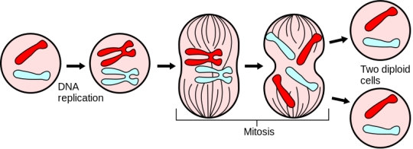
Overview of Gene Alterations
Gene alterations may be:
Hereditary (acquired by birth) and present in all cells of a body.
Somatic (acquired after birth) and present in only certain cells.
Somatic gene alterations (SGAs) can be caused by a number of factors, including:
Viruses such as human papilloma virus (HPV), which insert their genes in human DNA
Ultraviolet radiation and environmental factors (tobacco, benzene, etc.).
Mistakes during cell division (50-70 billion cells are replaced by new ones in an adult on average each day, and 2 million red blood cells are created per second for a total of an average 222-242 billion cells produced each day on average in an adult).
From http://askabiologist.asu.edu (right)
And
From http://www.ai.mit.edu/ (left)

Slide 9
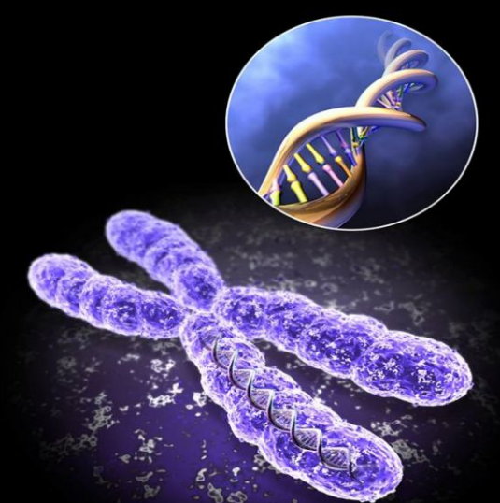
Overview of Gene Alterations
Major gene alterations reported in the DNA are:
Gene mutations refers to changes in the DNA sequence of a gene. Most are harmless and single base changes (point mutations).
Chromosomal instability refers to the loss of portions of chromosomes , or rearrangements of part of chromosome such as inversion, translocation, deletion, or insertion.
Copy number variation refers to sections of the genome being repeated and the number of repeats varying between individuals in a population.
Gene amplification refers to duplication of genes in the DNA.
Methylation refers to the addition of methyl groups on some nucleotides in the DNA.

Slide 10
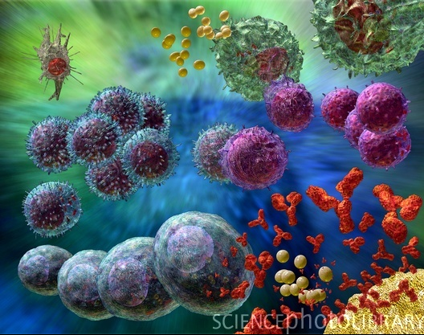
Overview of Gene Alterations
The effects of gene alterations may be:
Overexpression or underexpression of the corresponding gene.
Ex: gene amplification generates an overexpression of the corresponding mRNA.
Translation into new forms of proteins, which may lead more easily to a disease, or less so through the modification of their original function and regulation.
Ex: ABL-BCR protein is a different form of ABL; ABL is an oncogene, normally regulated, however ABL-BCR is not regulated in the same way, leading to an oncogene.
Suppression of a protein.

Slide 11
Overview of Gene Alterations
Certain genes are more important for certain diseases, therefore their alterations are more dangerous than others:
Oncogenes are genes known to promote the growth of cancer cells and associated phenotype. They are normally inhibited.
Proto-oncogenes are genes that produce proteins stimulating cell division. Mutations on these genes could cause cells to divide too rapidly, such as in cancer.
Tumor suppressor genes are genes known to protect against cancer because they inhibit cell division.
Generally several types of modifications are required for cancer or another disease to start.

Slide 12
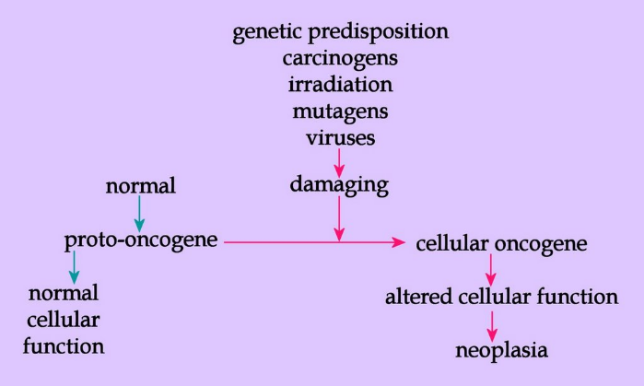
Overview of Gene Alterations
From http://oncologic.blogspot.com/

Slide 13
Outline
Introduction to module
Gene alterations and their consequences
Overview of gene alterations
Genetic mutations
Finding gene mutations
Methylation
Finding methylated genes
Copy number alterations
Finding copy number alterations
Genomic alterations and gene expressions
Linking genomic alterations and gene expressions
Gene alterations with R
R scripts to determine gene alterations

Slide 14
Genetic Mutations
Genetic mutations refer to DNA mutations such as:
Substitution of a nucleotide – also called in frame mutation because they do not cause a shift in the codon reading frame
Insertion of a nucleotide.

Slide 15
Genetic Mutations
Genetic mutations refer to
Deletion of a nucleotide – insertion and deletion are called frameshift mutations because they cause a shift in the codon reading frame.
They can affect
Only one nucleotide (point mutation or single base modification)
Several nucleotides.

Slide 16
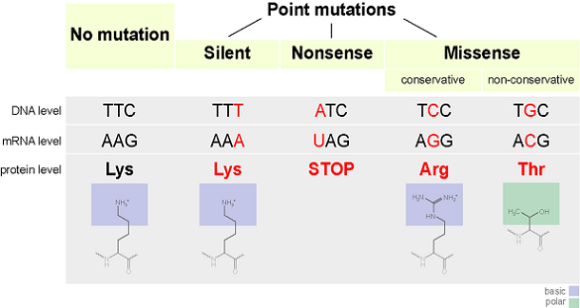
Genetic Mutations
More precisely, point mutations may be
Silent mutations do not change the protein expressed, therefore will have little effect on the biochemistry. They are also called synonymous.
Non-synonymous mutations are mutations altering the amino acid sequence of a protein. They can be:
Nonsense mutations add a stop or termination codon in the DNA, which will cause the generated protein to be shorter than it should. They are also referred to as truncating.
Missense mutations generate different codons, which may code for a different amino acid, therefore the resulting protein may be altered, sometimes dramatically.
From http://www.study.com

Slide 17
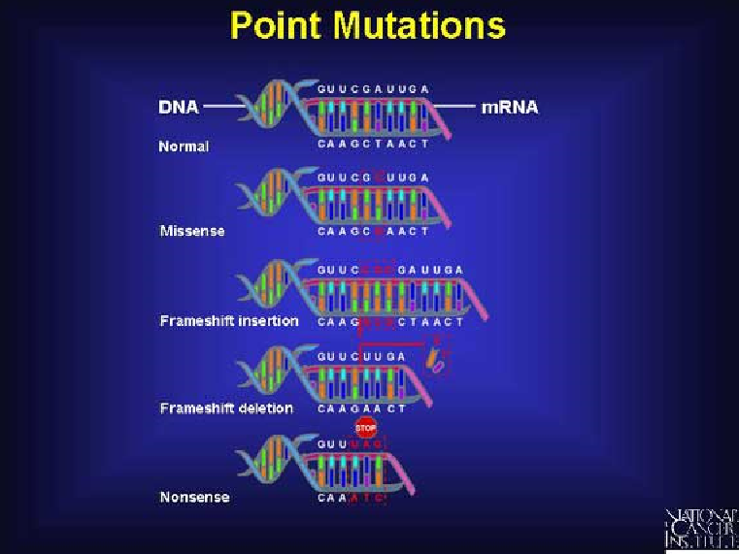
Genetic Mutations
Single point mutations may have a radical effect on a protein’s expression, because they may shift the frame of all codons following the mutation (frameshift mutation). It is the case on insertion and deletion of a nucleotide.
From National Cancer Institute

Slide 18
Genetic Mutations
Human beings have 2 copies of the same chromosome – one from their father and one from their mother – except for Y chromosome. They are called diploid.
However a particular gene may not exist in the same form, called allele, in both chromosomes – these individuals are said to be heterozygous for the gene.
Somatic mutations generally affect only one version of a gene.
Many common diseases originate in a mutation in a single gene passed on to future generations.
Ex: sickle-cell anemia is caused by a single missense mutation at codon 6 of the β-globin gene and affects 1 in 500 individuals of African descent.

Slide 19
Outline
Introduction to module
Gene alterations and their consequences
Overview of gene alterations
Genetic mutations
Finding gene mutations
Methylation
Finding methylated genes
Copy number alterations
Finding copy number alterations
Genomic alterations and gene expressions
Linking genomic alterations and gene expressions
Gene alterations with R
R scripts to determine gene alterations

Slide 20
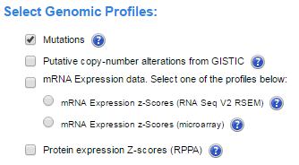
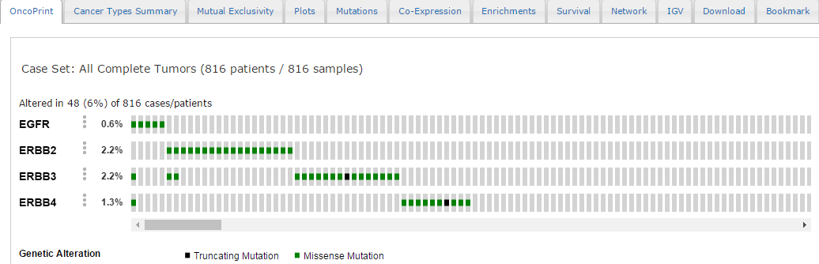
Finding Gene Mutations
cBioPortal may be used to study gene mutations in cancer patients under the Oncoprint tab after option: Mutations.
Example: EGFR ERBB2 ERBB3 ERBB4 in Breast cancer shows truncating and missense mutations.

Slide 21
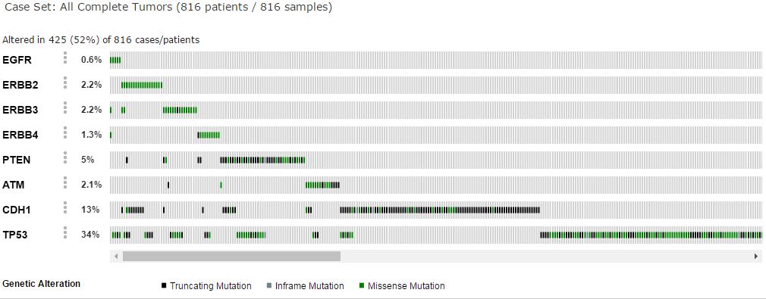
Finding Gene Mutations
Example: EGFR ERBB2 ERBB3 ERBB4 PTEN ATM CDH1 TP53 in Breast cancer.

Slide 22
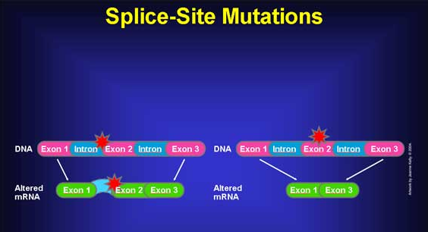
Finding Gene Mutations
Mutation types in cBioPortal
MISSENSE (in frame substitution with new AA)
NONSENSE (truncating)
NONSTART (changes start codon)
NONSTOP (changes stop codon)
FRAMESHIFT (shifts frame)
INFRAME (in frame substitution but no new AA)
SPLICE (genetic mutation that inserts, deletes, or changes a number of nucleotides in the specific site at which splicing takes place during transcription)
TRUNC (NONSENSE, NONSTART, FRAMESHIFT, and SPLICE).

Slide 23
Outline
Introduction to module
Gene alterations and their consequences
Overview of gene alterations
Genetic mutations
Finding gene mutations
Methylation
Finding methylated genes
Copy number alterations
Finding copy number alterations
Genomic alterations and gene expressions
Linking genomic alterations and gene expressions
Gene alterations with R
R scripts to determine gene alterations

Slide 24
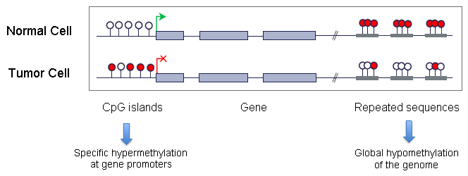
Methylation
Methylation is the addition of methyl groups (-CH3) on nucleotides in the DNA. It affects only C and A nucleotides.
Methylation has for effect to repress gene transcription and plays an important role in normal cell functioning.
However a change in the methylation process has been linked to many diseases, including cancer, schizophrenia, heart disease, type II diabetes, lupus, and aging.
From http://atlasgeneticsoncology.org/

Slide 25
Methylation
DNA methylation is critical for gene expression such that a specific methylation signature can be associated with diseases in a way similar to gene expression signatures (differentially expressed genes).
DNA methylation plays a role in the silencing of tumor suppressor genes in cancer and can help in cancer staging.
Whole genome sequencing data (methylome-seq) give us the ability to classify different subtypes of cancer based on methylation biomarkers and are more stable than RNA or proteins.
Methylation is linked to epigenetic modifications – those that are not part of the genetic material in chromosomes however affect it and can be passed onto offspring.

Slide 26
Outline
Introduction to module
Gene alterations and their consequences
Overview of gene alterations
Genetic mutations
Finding gene mutations
Methylation
Finding methylated genes
Copy number alterations
Finding copy number alterations
Genomic alterations and gene expressions
Linking genomic alterations and gene expressions
Gene alterations with R
R scripts to determine gene alterations

Slide 27
Finding Methylated Genes
Methylated genes are determined by analyzing bisulfite sequencing (BS-seq) data.
TCGA provides a number of methylation data for cancer, coming mainly from two methylation platforms:
Methylation450 (higher resolution and greater sample count), and
Methylation27.
Data can be analyzed to compare methylation between groups or between patients and normal.

Slide 28
Finding Methylated Genes
R packages for methylation data analysis:
Methylation analysis pipelines examples:
BSMAP (wild-card matching approach)
Bismark (three-letter alignment algorithm) maps bisulfite treated sequencing reads to a genome of interest and performs methylation calls.
Programs can extract this information and provide the list of genes being methylated.
methylPipeline (Bioconductor R package).
methyAnalysis (Bioconductor R package).

Slide 29
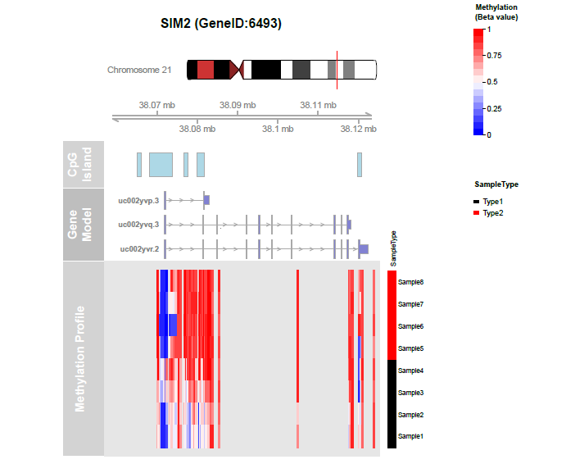
Finding Methylated Genes
Methylation heatmap for chromosome 21 (methyAnalysis)

Slide 30
Outline
Introduction to module
Gene alterations and their consequences
Overview of gene alterations
Genetic mutations
Finding gene mutations
Methylation
Finding methylated genes
Copy number alterations
Finding copy number alterations
Genomic alterations and gene expressions
Linking genomic alterations and gene expressions
Gene alterations with R
R scripts to determine gene alterations

Slide 31
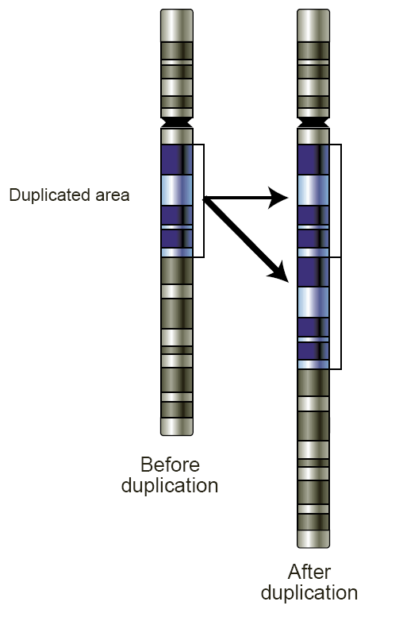
Copy Number Alterations
Copy number alterations refer to changes in the number of copies:
Gene amplification is when a gene has multiple copies resulting from aberrant DNA replication. It is also called gene duplication (in principle, any number of the same gene greater than two in humans and diploid species is an amplification). The number of copies can be very large and has clinical impact.
Gene copy number gain is when the number of copies of a gene is greater than 2 and is present for example in cancer cells (low gain, high gain). Gain is considered an amplification with few copies generated.
Gene deletion is when a gene or part of a gene is deleted from a chromosome:
Deep deletion or deletion below minimum median chromosomal arm copy number for that sample by at least 0.1.
Shallow deletion or deletion from 1.9 to deep deletion threshold..
Homozygous deletion or deletion of a gene on a single chromosome in considered a deep loss.
From Human Genome Research Institute.

Slide 32
Outline
Introduction to module
Gene alterations and their consequences
Overview of gene alterations
Genetic mutations
Finding gene mutations
Methylation
Finding methylated genes
Copy number alterations
Finding copy number alterations
Genomic alterations and gene expressions
Linking genomic alterations and gene expressions
Gene alterations with R
R scripts to determine gene alterations

Slide 33
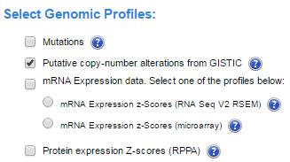
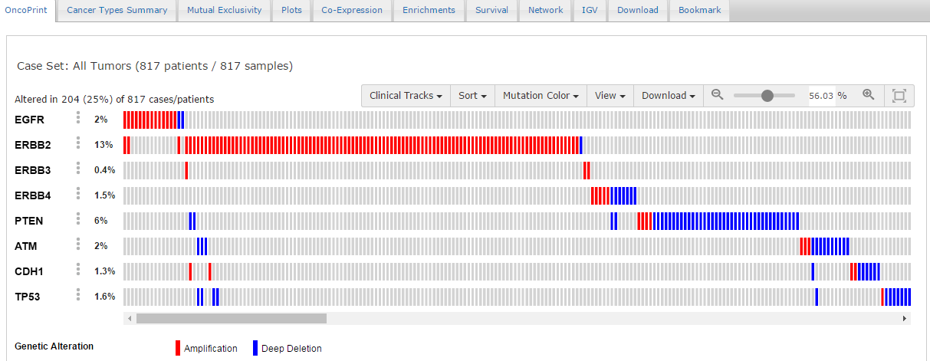
Finding Copy Number Alterations
cBioPortal may be used to study copy number alterations in cancer patients under the Oncoprint tab after option: Putative copy-number alterations from GISTIC.
Example: EGFR ERBB2 ERBB3 ERBB4 in Breast cancer shows amplification and deep deletion.

Slide 34
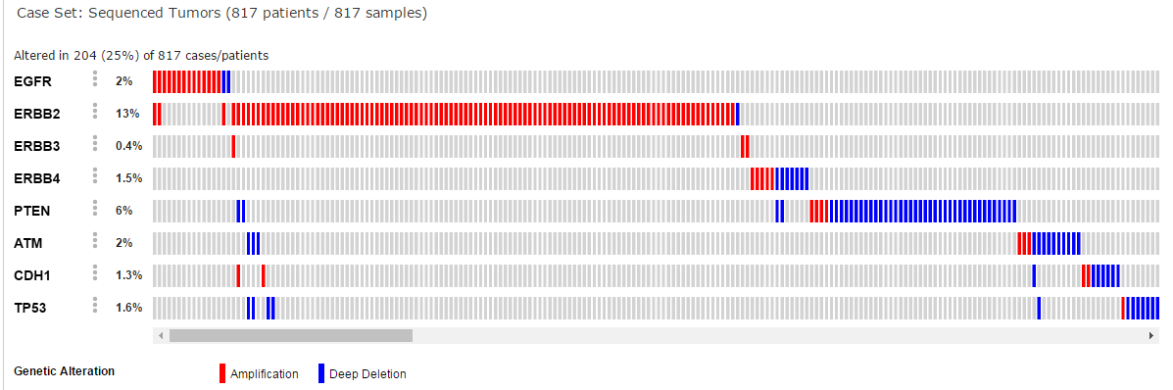
Finding Copy Number Alterations
Example: EGFR ERBB2 ERBB3 ERBB4 PTEN ATM CDH1 TP53 in Breast cancer.

Slide 35
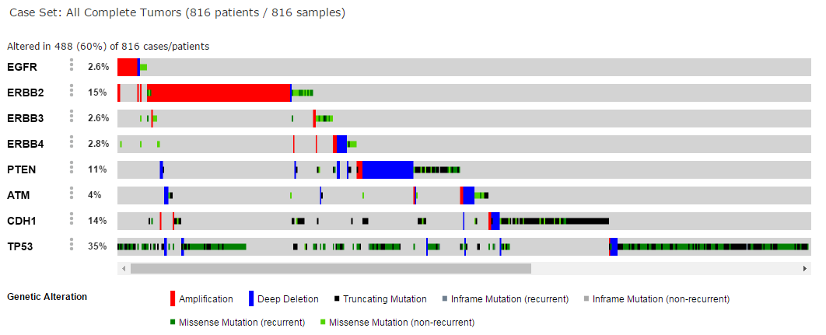
Finding Copy Number Alterations
Example: EGFR ERBB2 ERBB3 ERBB4 PTEN ATM CDH1 TP53 in Breast cancer with recurrence data.

Slide 36
Finding Copy Number Alterations
Software to identify copy number alterations include:
GISTIC (from Broad Institute, Linux-based).
Many others (https://omictools.com/cnv-detection2-category).
TCGA provides files already processed by GISTIC and ready for further analysis and quantification.

Slide 37
Outline
Introduction to module
Gene alterations and their consequences
Overview of gene alterations
Genetic mutations
Finding gene mutations
Methylation
Finding methylated genes
Copy number alterations
Finding copy number alterations
Genomic alterations and gene expressions
Linking genomic alterations and gene expressions
Gene alterations with R
R scripts to determine gene alterations

Slide 38
Genomic Alterations and Gene Expressions
There is a lot of evidence that genomic alterations are associated with dysregulated genes (upregulated or downregulated).
cBioPortal provides a tool of choice to observe this phenomenon on cancer data.
Even though both disturbances – gene alterations and gene expression modifications – are observed in many diseases, showing the causal effect is more difficult than showing that there is an association. Several clinical experiments have been designed to demonstrate this.

Slide 39
Outline
Introduction to module
Gene alterations and their consequences
Overview of gene alterations
Genetic mutations
Finding gene mutations
Methylation
Finding methylated genes
Copy number alterations
Finding copy number alterations
Genomic alterations and gene expressions
Linking genomic alterations and gene expressions
Gene alterations with R
R scripts to determine gene alterations

Slide 40
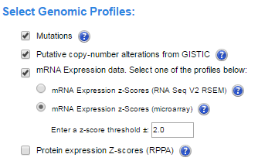
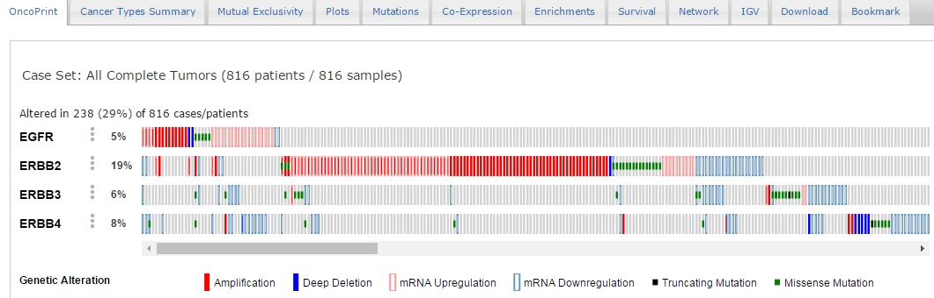
Linking Genomic Alterations and Gene Expressions
Example: EGFR ERBB2 ERBB3 ERBB4 in Breast cancer after options mutations, copy number variation, and mRNA expressions with z-score (upregulated = more than 2 STD above sample mean, downregulated same with more than 2 STD below).

Slide 41
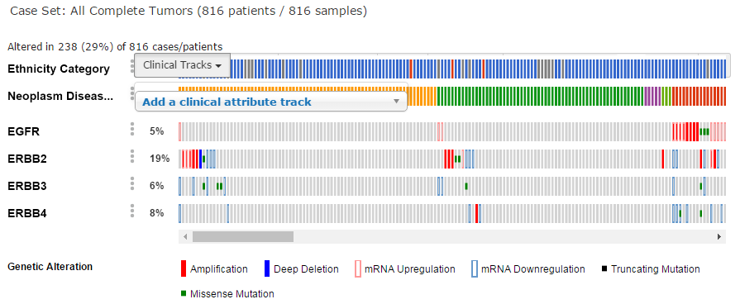
Linking Genomic Alterations and Gene Expressions
One can combine results with clinical data (by choosing in the drop-down ‘clinical tracks’ tab).

Slide 42
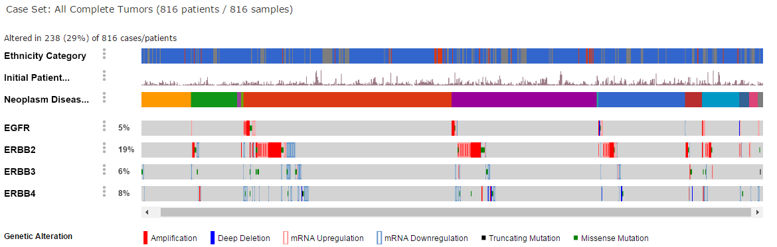
Linking Genomic Alterations and Gene Expressions
Clinical tracks can be sorted as well.

Slide 43
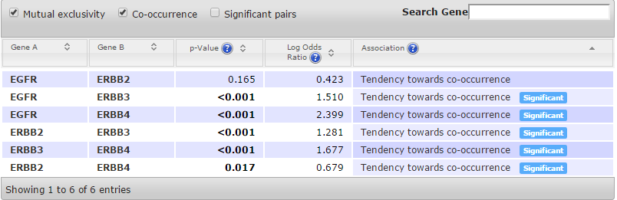
Linking Genomic Alterations and Gene Expressions
Other tabs include (these may change with different versions of cBioPortal):
Cancer types summary.
Mutual exclusivity.
Plots.
Mutations.
Co-expression.
Enrichments.
Survival.
Network.
IGV.
Download.
Bookmark.

Slide 44
Outline
Introduction to module
Gene alterations and their consequences
Overview of gene alterations
Genetic mutations
Finding gene mutations
Methylation
Finding methylated genes
Copy number alterations
Finding copy number alterations
Genomic alterations and gene expressions
Linking genomic alterations and gene expressions
Gene alterations with R
R scripts to determine gene alterations

Slide 45
Gene Alterations with R
We discussed several packages for gene alterations analysis with R, and there are many more, new packages are added every day:
Mutations
CancerMutationAnalysis
Copy number variations
seqCNA
R-Gada
CNV-seq
Methylation
methyAnalysis
methylPipeline.

Slide 46
Outline
Introduction to module
Gene alterations and their consequences
Overview of gene alterations
Genetic mutations
Finding gene mutations
Methylation
Finding methylated genes
Copy number alterations
Finding copy number alterations
Genomic alterations and gene expressions
Linking genomic alterations and gene expressions
Gene alterations with R
R scripts to determine gene alterations

Slide 47
R Scripts to Determine Gene Alterations
Watch the video
Start Jupyter notebook from the provided link

